Slide 1
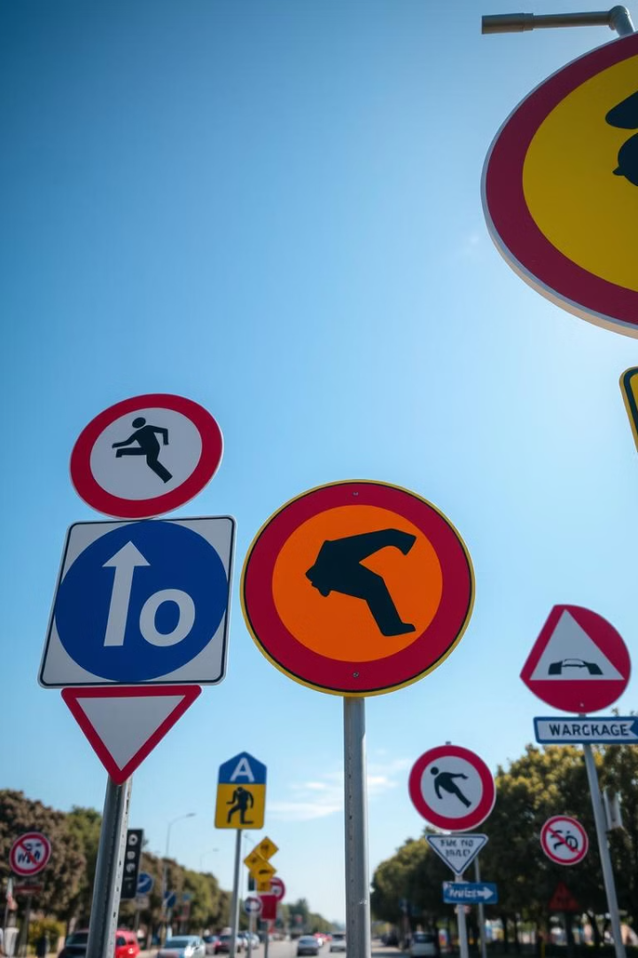
Traffic Sign Recognition

Slide 2
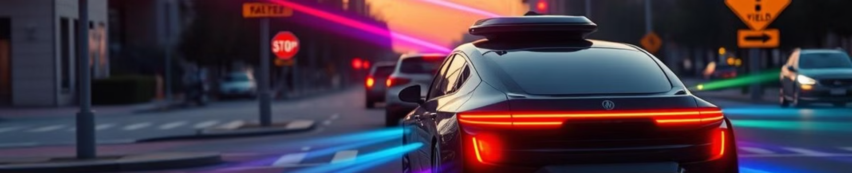
Introduction
Deep learning has revolutionized computer vision, especially in image classification.
Traffic sign recognition is a key part of ADAS and self-driving vehicles.
Achieving high accuracy and generalization in real-world conditions is a challenge.
Comparing custom CNN vs. pretrained VGG 16 and ResNet for multi-class traffic sign recognition.

Slide 3
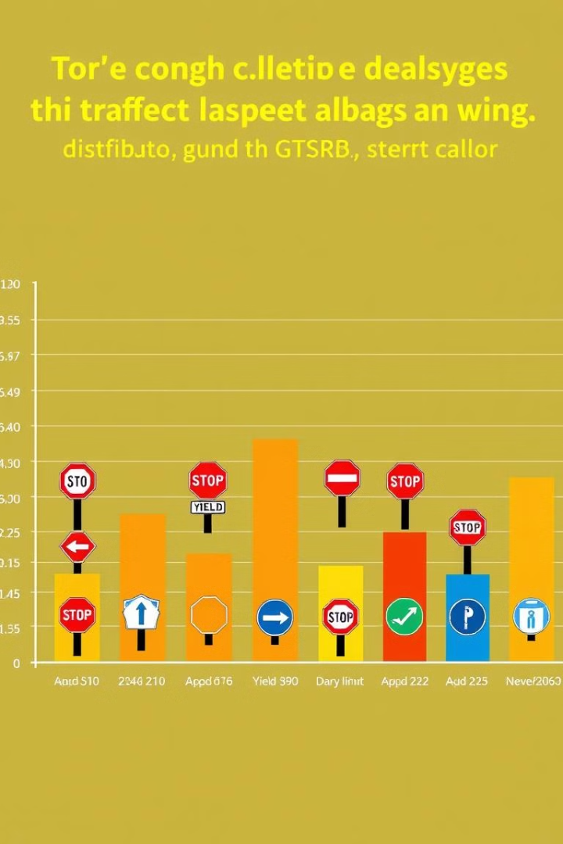
Dataset Information
German Traffic Sign Recognition Benchmark Dataset: Over 50,000 images of 43 traffic signs. Captured under varying conditions.
Classes Range: Speed limits, prohibitory signs, mandatory signs, danger warnings.
Image Shape: Standardized to 32x32x3.

Slide 4

Data Preprocessing
Resizing: Required due to varying image dimensions in the original dataset.
Normalization: Pixel values divided by 255 for faster and stable training.
Label Encoding: One-hot encoding to convert categorical labels to binary vectors.
Train-Validation Split: 80:20 split from training data for hyperparameter tuning.

Slide 5
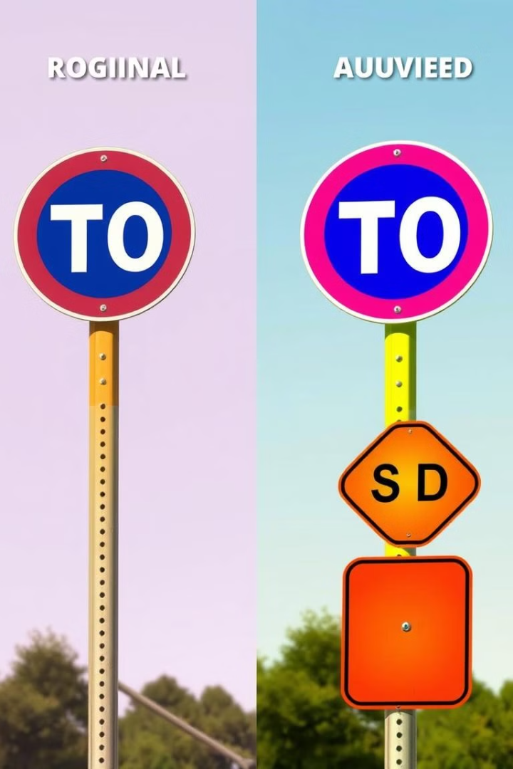
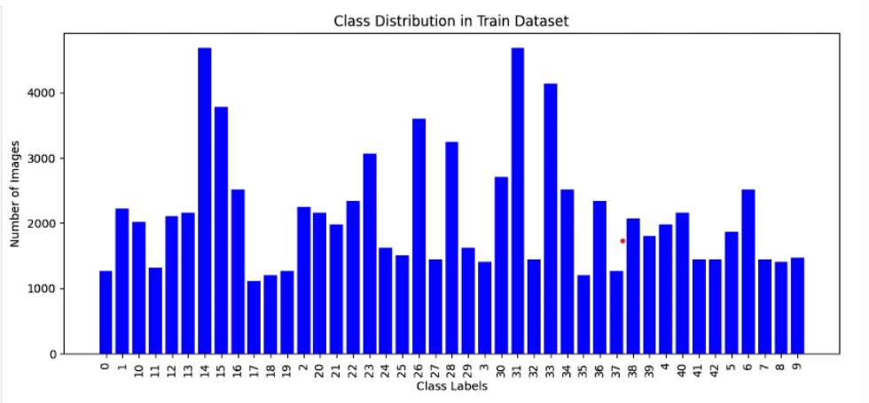
DISTRIBUTION OF DATASET

Slide 6
Handling Class Imbalance
Dataset has imbalanced classes that can bias the model.
Data augmentation using ImageDataGenerator addresses imbalance.
Common techniques uses oversampling through data augmentation to balance the dataset by generating new images for classes with fewer than 1000 samples. Unlike undersampling, which removes data from overrepresented classes(more than 3000), oversampling adds synthetic data to underrepresented ones, preserving all original information.
This artificially boosts minority class dataset sizes.

Slide 7
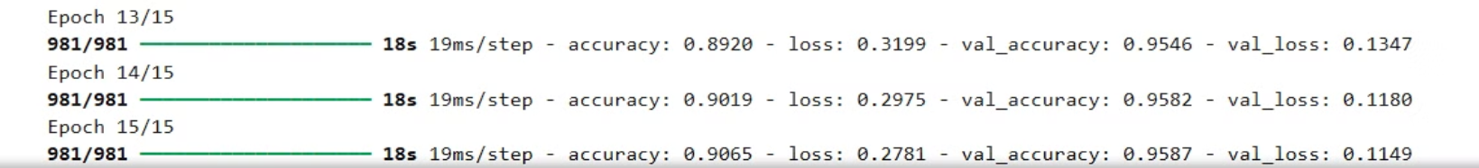
CNN Architecture
This CNN consists of three Conv2D and MaxPooling layers for feature extraction, followed by a Flatten layer, a Dense layer with 256 units for learning patterns, a Dropout layer to reduce overfitting, and a final Softmax layer for classifying 43 traffic sign categories.
Optimizer: Adam, Loss Function: Categorical Crossentropy.
ADAM: Adapts learning rates for each parameter based on gradient history, making training faster and more stable.
Epochs: 15, Batch Size: 32 Accuracy: 90%

Slide 8
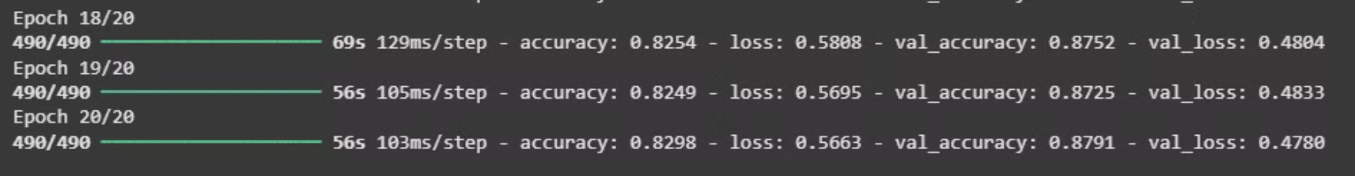
VGG16 Architecture
VGG16 is a 16-layer CNN model known for its simple architecture using 3×3 convolutions and max pooling.
It comes pretrained on ImageNet, making it useful for transfer learning for classification tasks.
In feature extraction, pretrained layers are frozen and only new classifier layers are trained.
In fine-tuning, some pretrained layers are unfrozen and retrained to adapt to the new dataset.
VGG16 Overview:13 convolutional layers pre-trained on ImageNet.
Optimizer: Adam. Accuracy Achieved: ~83%.

Slide 9
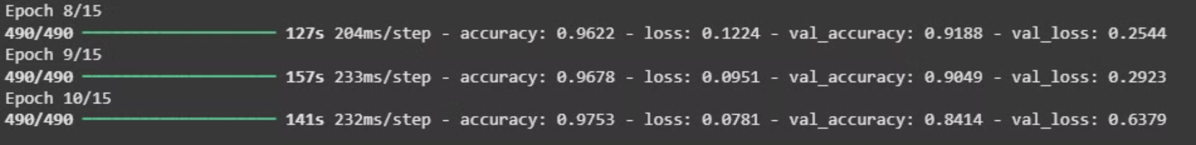
ResNet Architecture
ResNet is better than a traditional CNN because it uses skip connections to avoid vanishing gradients, allowing it to train much deeper and more accurate networks effectively.
ResNet16 takes 64×64×3 images, starts with Conv-BatchNorm-ReLU, and stacks residual blocks with 64, 128, and 256 filters using skip connections. It downsamples using stride=2 and 1×1 convolutions, ending with deep residual units for rich feature learning.
Optimizer: Adam, Loss Function: Sparse_categorical_crossentropy.
Epochs: 10, Batch Size: 64 Accuracy: 97.53%

Slide 10

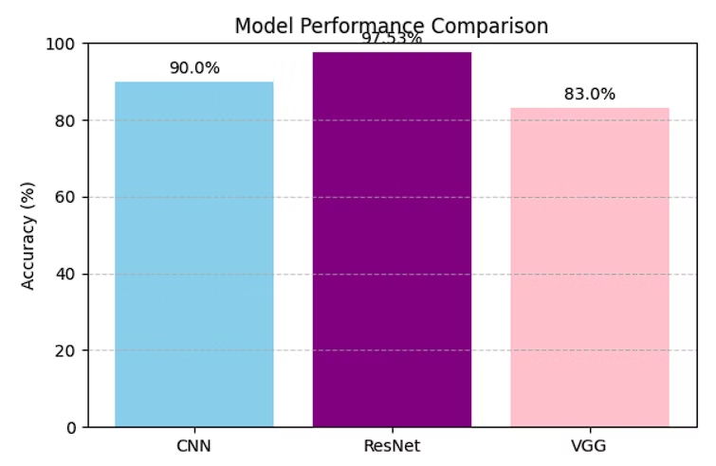
Performance Comparison
CNN: Accuracy: ~90%. Slight overfitting observed.
VGG16: Accuracy: ~83%. Stable loss and moderate accuracy with minimal overfitting.
ResNet: Accuracy~ 97.53%

